Slide 1


MEDICARE ADVANTAGE
And the Opportunity for Technology to Accelerate and Deliver Improved Clinical and Cost Outcomes
December 13, 2019
Matt White & Dr. Diego Martinez ⎸David Main ⎸Innovaceer

Slide 2
Goals and Meeting Agenda
AGENDA:
Medicare Advantage 101
Rise of Technology
Opportunities & Implications

Slide 3
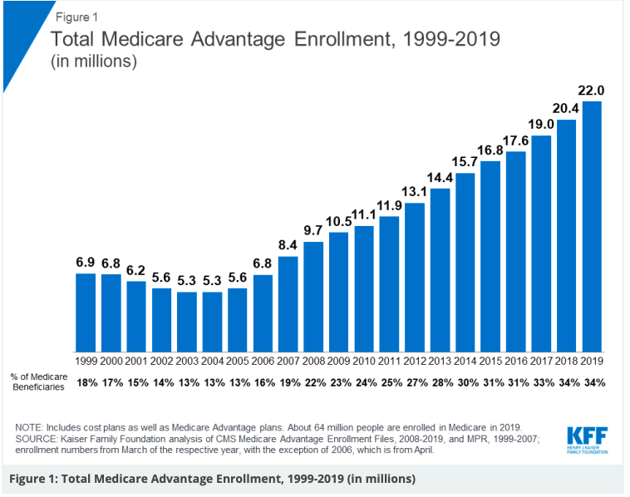
Medicare Part C aka Medicare Advantage 101
Benefits | TM | MA
Part A & B Premium & Coverage | ✔ | ✔
Part D, Vision, Hearing, Dental |  | ✔
Out of Pocket Maximums |  | ✔
SNF requires 3-day Hospital Stay | ✔
Coverage Changes Annually |  | ✔
Supplemental Benefits |  | ✔
Early 2020 AEP results have growth >2M.
Projections by LEK have 70% Penetration bw 2030-2040.
Notes:
https://www.kff.org/medicare/issue-brief/a-dozen-facts-about-medicare-advantage-in-2019/
MA: https://www.navigant.com/insights/healthcare/2019/medicare-advantage-extend-advantage
https://www.lek.com/sites/default/files/insights/pdf-attachments/1969_Medicare_AdvantageLEK_Executive_Insights_1.pdf
Medicare Health Plans
Original Medicare vs. Medicare Advantage
Understanding your Medicare choices
By Karen Lewis-Smith
Regional Director, Government Programs, Kaiser Foundation Health Plan of Washington
If you're nearing age 65 or have already reached that milestone, you've undoubtedly heard about Original Medicare and Medicare Advantage. Even if you choose Medicare Advantage, remember you'll need to first enroll in Original Medicare (Medicare Parts A and B).
To decide which option is best for you, you'll need to consider your health care needs, budget, and personal preferences. Read on for a summary of facts that will help you weigh the pros and cons of each coverage approach.
What it is
Original Medicare: Federal government's traditional no-frills fee-for-service plan.
Medicare Advantage: Also known as Medicare Part C or MA plans, these are offered by private insurance companies and approved and partially funded by the federal government.
Who's eligible
Original Medicare: American citizens and permanent residents who are 65 years of age or older or who have collected disability benefits for 2 or more years.
Note: Those diagnosed with amyotrophic lateral sclerosis (ALS) or end-stage renal disease (ESRD) are exempt from the 2-year waiting period.
Medicare Advantage: Most people who are enrolled in both Medicare Parts A and B.
What it covers
Original Medicare: Includes Medicare Part A (inpatient hospital coverage) and Part B (outpatient medical services).
Medicare Advantage: The same inpatient and outpatient services as Original Medicare. In addition, plans often include Medicare Part D (also known as Medicare Advantage prescription drug plans); vision, hearing, and dental benefits; and health and wellness services.
What it costs
Original Medicare: For most people, there's no premium for Part A.¹ You pay a Part B monthly premium, plus deductibles, copayments, and coinsurance (usually 20 percent of the Medicare-approved cost of the services covered by Part B).
Medicare Advantage: You pay a Part B monthly premium, and your plan's premium, if it charges one. You'll also pay the plan's deductible, if applicable, and copays (a fixed dollar amount) or coinsurance (a percentage of the cost) for each office visit.
Out-of-pocket spending limits
Original Medicare: There is no limit on what you spend on health care. If you have a serious accident or illness, you'll continue to be responsible for a portion of the costs, no matter how expensive it gets.
Medicare Advantage
Out-of-pocket limits apply in some cases:
Plans must have an annual out-of-pocket limit, which protects you if you need expensive care. Once you reach that limit, the plan pays for all covered medical expenses for the rest of the calendar year.
The limit does not apply to Part D (prescription drug) benefits and other non-CMS-covered expenses such as vision and hearing hardware and optional dental coverage.
Providers
Original Medicare
What you need to know about providers for Original Medicare:
You may see any doctor in the United States who accepts Medicare. If you go to a doctor who doesn’t accept Medicare, you could pay more for services.
No referrals are needed to see specialists.
Medicare Advantage
What you need to know about providers for Medicare Advantage:
Most plans require you to visit doctors, hospitals, and other health care providers within the plan’s provider network. (It's one way they keep premiums reasonable.) If you get nonurgent or non-emergent care outside the network, you may be responsible for paying the entire bill.
Referrals may be needed to see specialists.
Other considerations
Original Medicare:
Here's what to consider when you're looking at Original Medicare:
Original Medicare doesn't include prescription drug coverage, so you may want to buy a separate standalone Part D (prescription drug) plan if you take a lot of medications. When choosing a Part D plan, find out if the medications you take are available on the plan formulary and how much they cost.
You may want Medicare supplemental insurance (Medigap) to help pay out-of-pocket costs that Original Medicare doesn't cover.
You'll need to coordinate with multiple insurers, in addition to the federal government.
A 3-day hospital admission is required to qualify for skilled nursing facility coverage.
Medicare Advantage:
Here's what to consider when you're looking at Medicare Advantage:
Plans can combine health and drug coverage in one plan which usually includes additional benefits — vision, hearing, and dental benefits, and health and wellness services.
For questions and claims, you deal with just one company.
You'll want to find out if the medications you take are available on the plan formulary and how much they cost.
You can't add Medicare supplemental insurance (Medigap) to an MA plan.
Most plans have dropped Medicare's requirement of a 3-day hospital admission to receive skilled nursing facility coverage.
For more information about how Medicare works, visit medicare.gov or call Social Security at 1-800-772-1213. Or check out our latest videos about Medicare coverage, costs, and enrollment periods.
Learn about Medicare plans for group, state, and federal employees
If you are becoming eligible for Medicare and your employer offers a group retiree Medicare Advantage health plan through Kaiser Permanente Washington, call us at 1-800-581-8252 or TTY WA Relay 711 from 8 a.m. to 5 p.m., Monday through Friday.
PEBB and FEHB members can also find information online:
PEBB (Public Employees Benefits Board) Program health plans
FEHB (Federal Employees Health Benefits) Program health plans
Enroll in a Kaiser Permanente Medicare health plan now²
Attend a seminar >>
Enroll now >>
Request free* enrollment information >>
Questions? Call us:
Prospective members
8 a.m. to 8 p.m., 7 days a week
1-800-446-8882
TTY WA Relay 711
Current members
MEMBER SERVICES
8 a.m. to 8 p.m., 7 days a week
1-888-901-4600
TTY WA Relay 711
Articles
7 tips for choosing a Medicare plan
When am I eligible for Medicare benefits and when do I need to enroll?
How the Medicare Part D donut hole works
Other resources
Glossary
Washington's highest-rated Medicare plan
When you choose a Kaiser Permanente Medicare Advantage health plan, you get high quality care and coverage — all in a single plan that offers great value. And you get the only Medicare health plan in Washington rated 5 out of 5 stars in 2020 — Medicare's highest rating.³
NCQA Quality Rating
Kaiser Permanente Washington Medicare Advantage (HMO) plan was rated 4.5 out of 5 in the National Committee for Quality Assurance (NCQA) Medicare Health Insurance Plan Ratings 2019-2020.⁴
Disclaimers
Kaiser Permanente is an HMO plan with a Medicare contract. Enrollment in Kaiser Permanente depends on contract renewal. You must reside in the Kaiser Permanente Medicare health plan service area in which you enroll. For accommodations of persons with special needs at meetings, call 1-800-446-8882 (TTY WA Relay 711).
*Free with no obligation.
¹If you've had a job in the United States and paid Medicare taxes for about 10 years, you won't pay a premium for Part A coverage.
²You must meet all Medicare health plan enrollment requirements.
³Every year, Medicare evaluates plans based on a 5-star rating system. The star rating applies to Kaiser Foundation Health Plan of Washington.
⁴Kaiser Foundation Health Plan of Washington. The National Committee for Quality Assurance (NCQA) is a private, 501(c)(3) not-for-profit organization dedicated to improving health care quality. It issues health insurance plan ratings and Quality Compass Health Plan Quality Measures for Comercial and Medicare plans each year.
H5050_19WEB
Page last updated: November 19, 2019 at 10 a.m. PT
FOLLOW US
NONDISCRIMINATION NOTICE AND LANGUAGE ASSISTANCETerms of Use and Privacy Policy
© 2019 Kaiser Foundation Health Plan of Washington

Slide 4
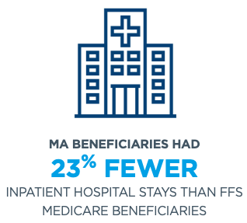
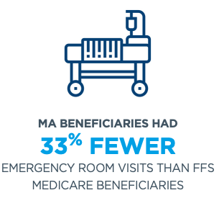
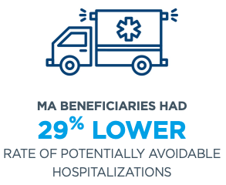
Mechanics of MA Incents Preventive, Efficient, Effective Care
Revenue
Expenses
Profit
Pts
Prem
Unit Cost
Util.
STARS
RAF
Net-work
Bene-fits
10,000 Lives, $800 Premium, 85%POP, 1.0 RAF, 80% MER
PMPM | 680
PMPY | 8,160
TOTAL REVENUE | 81,600,000
COSTS | 65,280,000
PROFIT | 16,320,000
Notes:
https://www.bettermedicarealliance.org/about-medicare-advantage/medicare-advantage-achieves-better-outcomes-traditional-medicare

Slide 5
Technology Information Abounds. Is it actionable and does it lower cost & improve outcomes?
TO PREDICT, timely and consistently
Patient Behaviors
Adverse Clinical Events
TO ENGAGE, in a patient-preferred way
Patients
&
Family
Clinician
TO PERFORM, efficiently and effectively
Diagnostics & Treatment
Right Setting

Slide 6
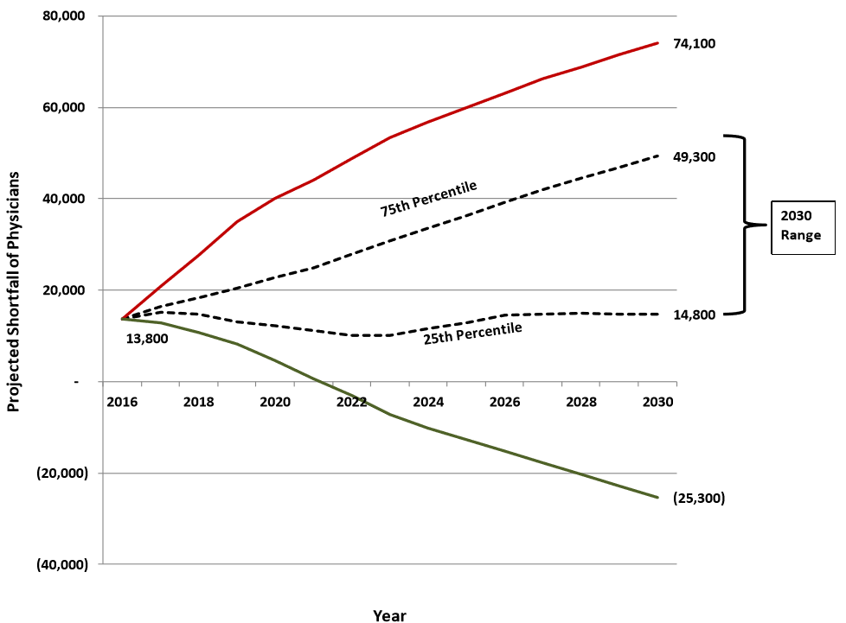
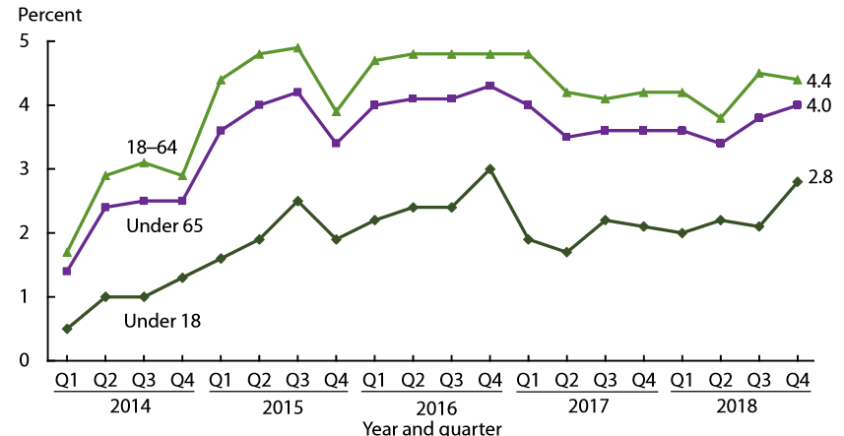
Government Markets are Poised for Sustainable Growth: Access, Quality, CC Outcomes
Opportunity and Implications of Technology
Shortfall of over 100K Physicians by 2030 | State Exchange Coverage has More than Doubled across Demographics over 4 Years
MARKET: Heightened competition for patients Current models of care falling short of patient needs Growth amongst payors creates risk of heightened administrative burdens and lower net reimbursement | MEDICAL GROUP OPPORTUNITY: Balance access with clinical and cost outcomes Contract so that incentives are aligned – patient experience, clinical and cost outcomes Collaborate with Payors to Grow in Partnership, potentially with subsidies | TECHNOLOGY: Efficiency, effectiveness and outcomes Data Connectivity and Synthesis Rules-based Algorithms, Predictive Analytics and Artificial Intelligence Guided Clinical Decision Making Telemonitoring and Remote Patient Monitoring/Wearables Virtual Medicine

